Slide 1


AI/ML Implementaion Chatbot Using NLP

Slide 2

Learning Objectives
This chatbot project is all about learning how to make machines understand and respond to human language in a meaningful way. By building this chatbot, you'll gain hands-on experience with Natural Language Processing (NLP), Machine Learning, and Web Development.
What You'll Learn:
🔹 How Chatbots Work – You'll understand the basics of chatbots, how they process user input, and generate responses.
🔹 Natural Language Processing (NLP) – Learn how to clean and prepare text, use TF-IDF vectorization, and classify user queries based on intent.
🔹 Machine Learning for Intent Recognition – Train a chatbot using Logistic Regression to classify user messages and respond accordingly.
🔹 Building an Interactive Chat Interface – Use Streamlit, a simple and powerful Python framework, to create a user-friendly chatbot interface.
🔹 Data Handling & Storage – Learn to store chatbot intents in a JSON file and log conversations in a CSV file for future improvements.
🔹 Improving Chatbot Conversations – Add randomness to chatbot responses to make interactions feel more natural.
🔹 Future Possibilities – Explore how you can take this chatbot further with deep learning, voice interaction, or real-time APIs.
GOAL
Source :
https://github.com/Sahillandage/AI-ML-Chatbot-Using-NLP-.git

Slide 3
Tools and Technology used
This chatbot is built using a mix of machine learning, NLP, and web technologies to create a smart and interactive assistant. Here’s a look at what makes it work:
🛠 Programming Language
Python – The backbone of this project, powering everything from text processing to machine learning.
🧠 Natural Language Processing (NLP)
NLTK (Natural Language Toolkit) – Helps break down and understand user input.
TF-IDF (Term Frequency-Inverse Document Frequency) – Converts text into numbers so the machine learning model can analyze it.
🤖 Machine Learning
Scikit-learn – Used to train a Logistic Regression model that helps predict user intent based on their messages.
💻 Web Interface & User Interaction
Streamlit – A simple and interactive way to build the chatbot’s web interface. It allows users to chat directly from their browser.
📂 Data Storage & Logging
JSON (JavaScript Object Notation) – Stores predefined questions (patterns) and responses for the chatbot.
CSV (Comma-Separated Values) – Keeps a history of conversations so interactions can be analyzed later.
⚙️ Development & Deployment
Jupyter Notebook – Used for experimenting and fine-tuning the chatbot’s logic.
VS Code / Terminal – Where the chatbot script is written and executed.
🔧 Other Helpful Tools
OS Module – Manages file paths and directories.
Datetime Module – Records timestamps for chatbot conversations.
Random Module – Helps make chatbot responses feel more natural by picking from multiple possible replies.

Slide 4
.
.
Methodology
This chatbot follows a simple yet effective approach to understand user queries and respond intelligently. Here's a quick breakdown of the process:
1. Understanding User Input
When a user types a message, the chatbot first preprocesses the text using NLTK (tokenization, removing unnecessary characters, etc.).
2. Identifying Intent
The chatbot uses TF-IDF vectorization to convert text into a numerical format and then applies a Logistic Regression model to predict the intent of the message.
3. Generating a Response
Once the chatbot identifies the intent, it selects a random response from the predefined answers stored in intents.json.
4. Displaying the Response
The response is then displayed in the Streamlit web interface, creating a smooth and interactive user experience.
5. Logging the Conversation
Each chat session is logged in a CSV file, capturing the user’s input, chatbot response, and timestamp. This helps in analyzing interactions and improving responses.

Slide 5
Problem Statement:
In today's digital world, users often seek quick and accurate responses to their queries. However, traditional customer support methods can be slow, costly, and require human intervention. This project aims to build an AI-powered chatbot that can:
✅ Understand user intent using Natural Language Processing (NLP).
✅ Provide instant, relevant responses based on predefined intents. ✅ Offer a simple and interactive web interface for seamless communication. ✅ Store chat history for further analysis and improvement.
Key Challenges Addressed:
🔹 Automating conversations without needing human support. 🔹 Ensuring accurate intent recognition using machine learning (Logistic Regression). 🔹 Making the chatbot easy to use with a Streamlit-based UI. 🔹 Allowing customization by modifying chatbot intents and responses.
This chatbot serves as a starting point for developing intelligent conversational agents that can be integrated into customer service, educational platforms, and various other domains.

Slide 6
Solution:
To address the problem of delayed and inefficient responses in customer support or general queries, this project provides a machine learning-based chatbot that:
✅ Understands User Intent – Uses Natural Language Processing (NLP) with TF-IDF vectorization and Logistic Regression to classify user queries.
✅ Provides Instant Responses – Fetches relevant answers from a predefined intent-response database (intents.json), ensuring quick and accurate replies.
✅ Easy-to-Use Interface – A Streamlit-powered web app makes interactions smooth and user-friendly.
✅ Logs Conversations for Analysis – Stores user queries, chatbot responses, and timestamps in a CSV file, allowing improvements based on user interactions.
✅ Highly Customizable – The chatbot’s knowledge base can be easily expanded by modifying the intents.json file, making it adaptable to different applications.
How This Solution Helps:
🚀 Reduces the need for human intervention in answering repetitive queries. 🚀 Offers a scalable and cost-effective alternative to traditional customer support. 🚀 Can be extended with deep learning, API integrations, and voice interactions for a smarter AI assistant.
This chatbot is a step towards intelligent automation, making information more accessible and interactions more efficient.

Slide 7
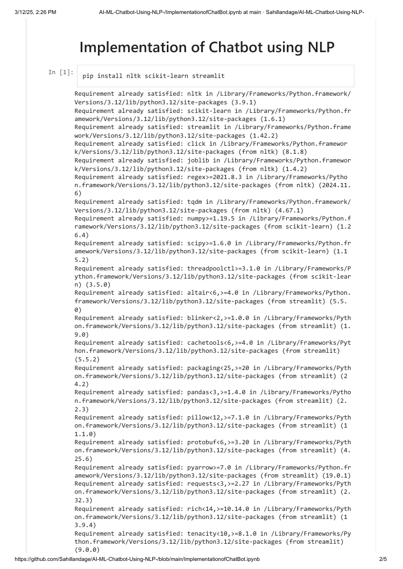
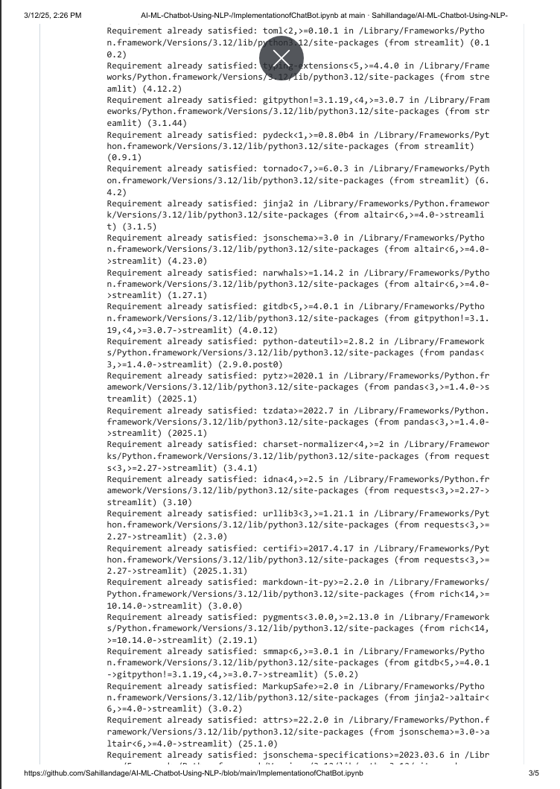
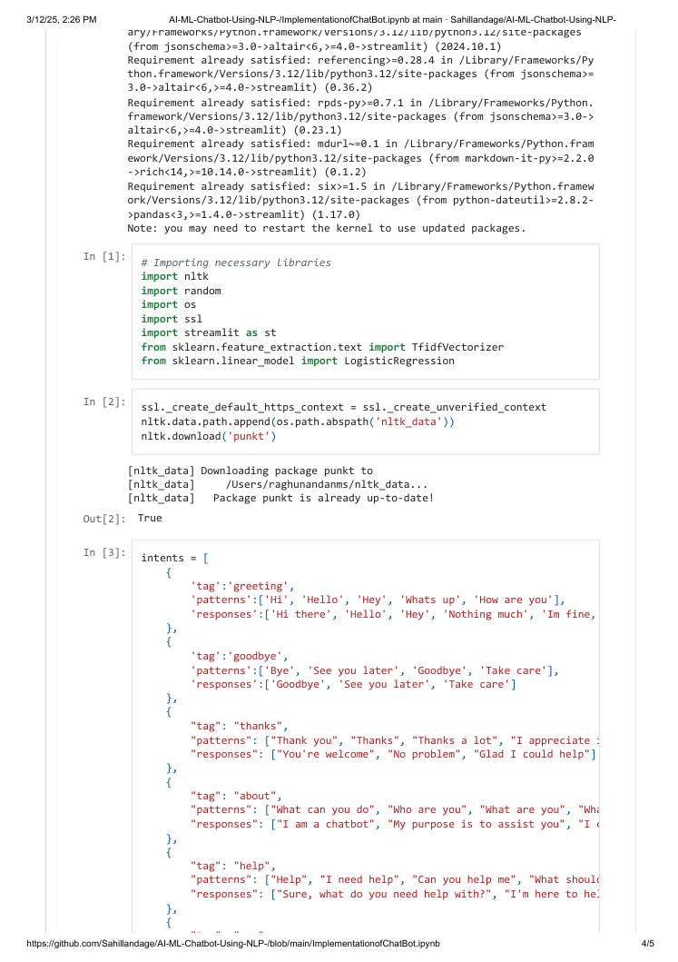
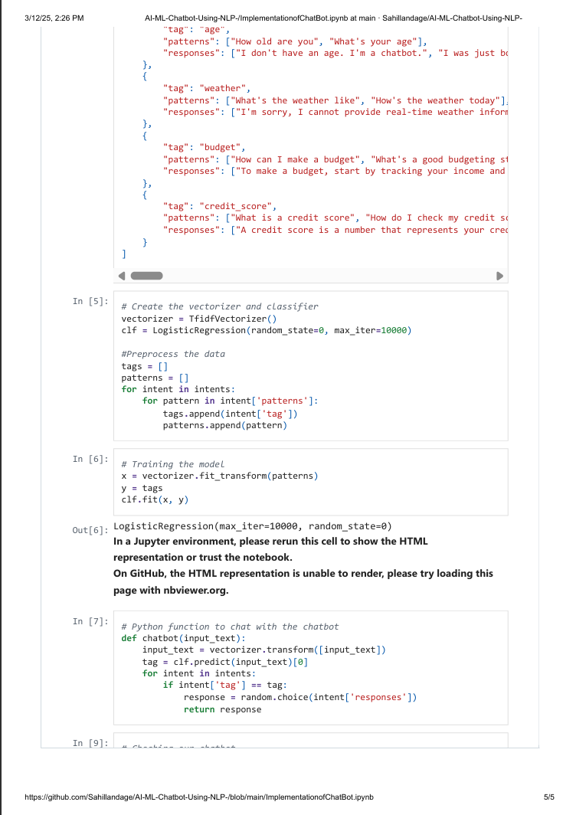
Screenshot of Output:

Slide 8
Source code (Github Link):-
https://github.com/Sahillandage/AI-ML-Chatbot-Using-NLP-.git

Slide 9
Conclusion:
This chatbot project successfully implements a conversational AI system using Natural Language Processing (NLP) and Machine Learning techniques. The chatbot is trained on a set of predefined intents and responses, enabling it to understand user queries and provide relevant answers. The key aspects of this project include:
NLP & Machine Learning – The chatbot utilizes TF-IDF vectorization and Logistic Regression to classify user input and generate appropriate responses.
Data-Driven Approach – The chatbot is trained on a well-structured intents dataset, which helps in mapping different user queries to relevant categories.
Interactive User Interface – The chatbot is deployed using Streamlit, making it accessible via a web interface for real-time user interaction.
Logging Conversations – User inputs and chatbot responses are stored in a CSV file, ensuring that past conversations can be analyzed for improvements.
Scalability & Future Enhancements – This project can be further improved by integrating deep learning models (e.g., transformers or LSTMs) for better understanding, as well as adding real-time APIs for enhanced functionalities such as weather updates or news.
Final Thoughts
This chatbot serves as a foundation for building intelligent virtual assistants and can be extended for various applications, including customer support, education, and personal assistance. By leveraging NLP advancements and AI-driven techniques, the chatbot can evolve into a more conversational, context-aware, and adaptive system.

